Slide 1
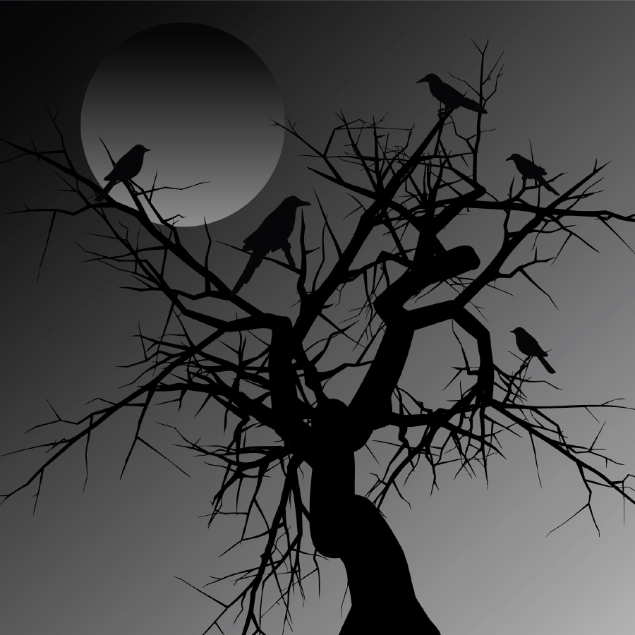
WHY DO WE READ HORROR STORIES?

Slide 2
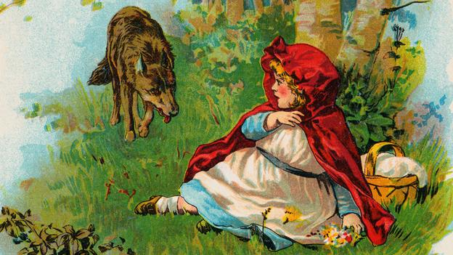
Childhood is scary !!!!!

Slide 3
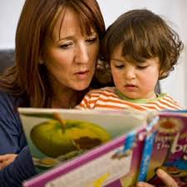
Reding about scary things with an adult can help us to deal with fear.

Slide 4
Sometimes the powerless can become powerful!!

Slide 5
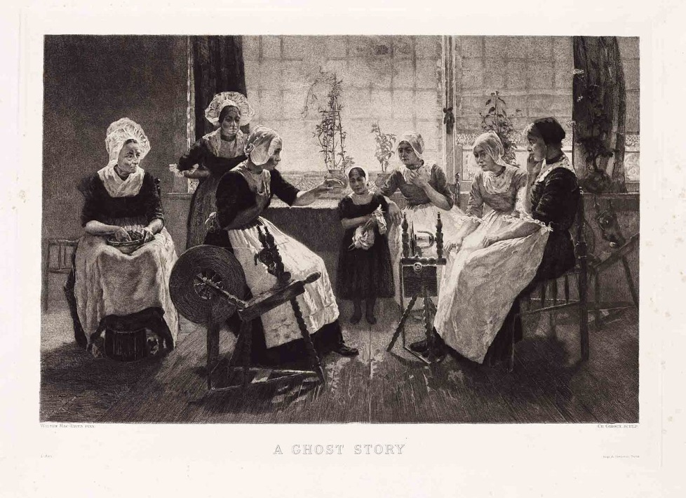
Sharing stories help us to think about good and bad, right and wrong.

Slide 6
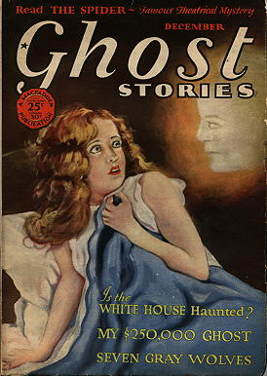
Getting a fright gives us an adrenaline rush!

Slide 7
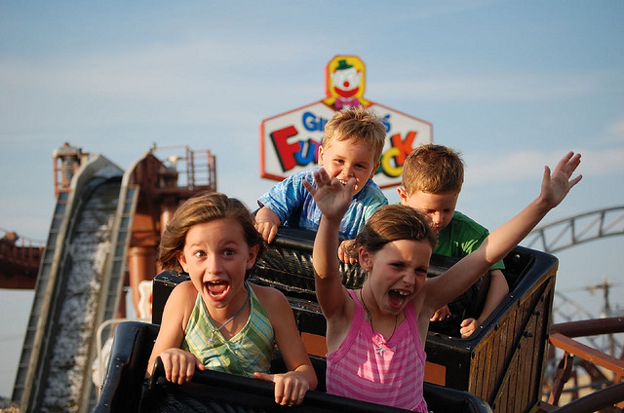
Just like a roller coaster ride

Slide 8
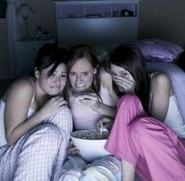
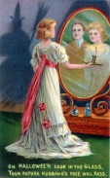
Scary stories bring people together!

