Slide 1
Texts related to the themes and ideas in Macbeth

Slide 2
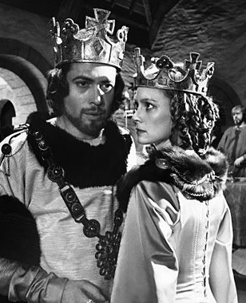
The Plot
A brave Scottish general named Macbeth receives a prophecy from a trio of witches that one day he will become King of Scotland. Consumed by ambition and spurred to action by his wife, Macbeth murders King Duncan and takes the Scottish throne for himself. He is then wracked with guilt and paranoia. Forced to commit more and more murders to protect himself from enmity and suspicion, he soon becomes a tyrannical ruler. The bloodbath and consequent civil war swiftly take Macbeth and Lady Macbeth into the realms of madness and death.

Slide 3
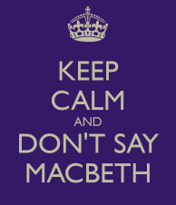
INTERESTING TRIVIA
‘THE SCOTTISH PLAY’
In the backstage world of theatre, some believe that the play is cursed, and will not mention its title aloud, referring to it instead as "The Scottish Play". Over the course of many centuries, the play has attracted some of the most renowned actors to the roles of Macbeth and Lady Macbeth. It has been adapted to film, television, opera, novels, comics, and other media.

Slide 4
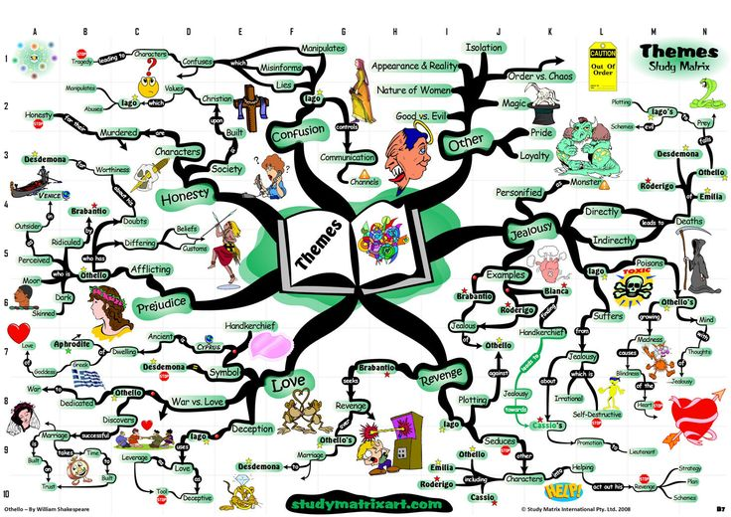
What is a theme?
Themes are universal and timeless ideas

Slide 5
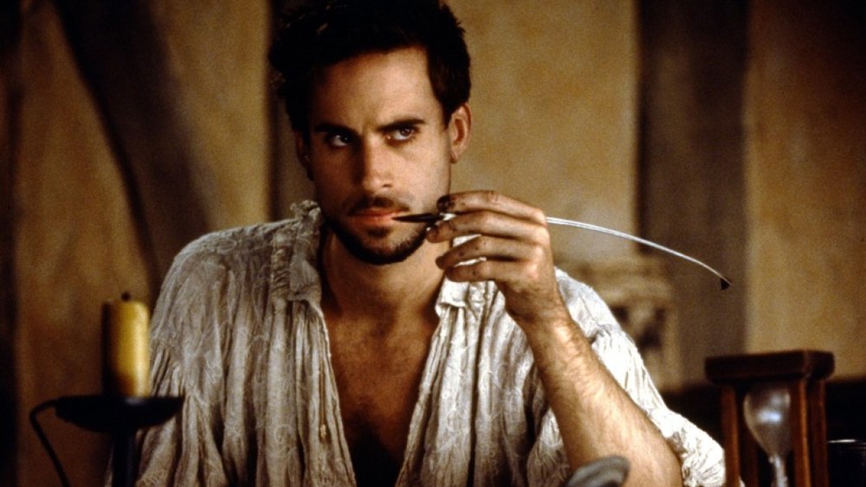
Thwarted love, ambition, greed, jealousy, fear – if you want to write a story about a fundamental predicament, there is a Shakespeare play to fit the bill. So it's not surprising that we see reminders of his words in every aspect of life and in many other stories.

Slide 6
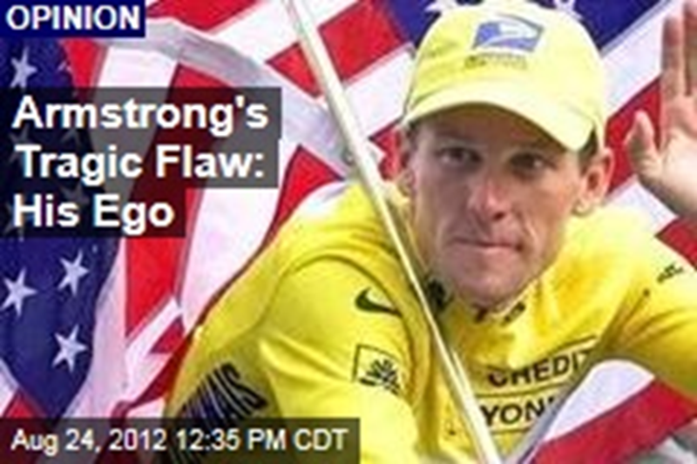
THEME – TRAGIC HERO
All of Shakespeare’s tragic heroes (and you could argue that Macbeth is one, despite his tyranny) have great potential but end up falling from grace because of a flaw.
Lance Armstrong’s Tale is as Timeless as Shakespeare

Slide 7
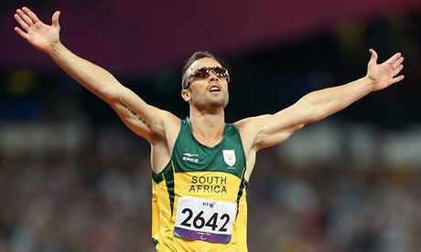
Oscar Pistorius, our flawed hero, has fallen
Oscar Pistorius is convicted of murder in “a tragedy of Shakespearean proportions”
https://www.theguardian.com/sport/2013/feb/14/oscar-pistorius-flawed-hero-fallen

Slide 8
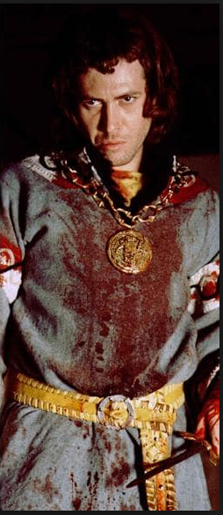
Some other themes in Macbeth are to do with:
Power – how it’s used
Kingship – What it means to be a good king/queen
Ambition – the consequences of having too
much
Murder – what it does to your mind
Fate and superstition – Can we control our
destiny?
Gender – What is the nature of man and woman?
Marriage – A good marriage or a toxic one
Nature – The natural order and what happens
when we interfere
And many more…..

Slide 9
Theme - Kingship
There are two examples of Kingship in Macbeth:
Macbeth himself and Duncan.
Through these characters we are asked to think about what does it mean to be a good King or QUEEN in general?
Some books dealing with this topic include:

Slide 10
Theme - Kingship

Slide 11
THEME – THE NATURAL ORDER
People in Shakespeare’s day believed in what they called The Great Chain of Being, with God at the top, the Angels just below him, and then everything in the Earthly realm below them, in order of importance.

Slide 12
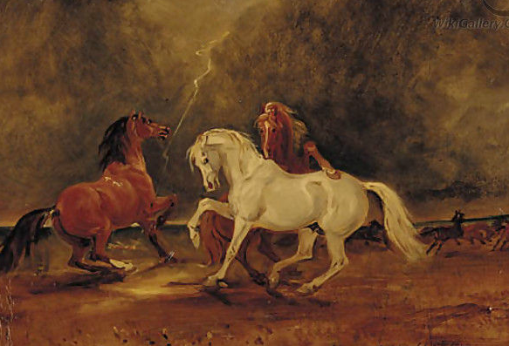
DISTURBING THE NATURAL ORDER
After King Duncan is murdered by Macbeth, we learn "unnatural" things have been going on. Even though it's the middle of the day, the "dark night strangles the traveling lamp," i.e. an eclipse (2.4.9).
And that's not all. We also learn that an owl was seen killing a falcon and Duncan's horses went wild and began eating each other (2.4.13-24). Clearly, nature has been disturbed

Slide 13
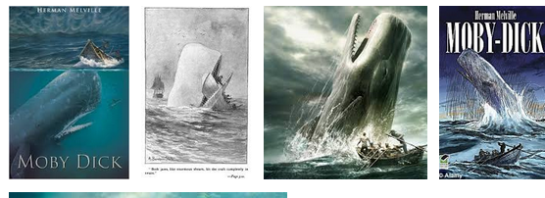
THEME – THE NATURAL ORDER - Moby Dick
Melville's Great American Novel draws on both Biblical and Shakespearean myths. Captain Ahab is "a grand, ungodly, god-like man … above the common" whose pursuit of the great white whale is a fable about obsession and over-reaching. Just as Macbeth subverts the natural order of things, Ahab takes on Nature in his determination to kill his prey – and his hubristic quest is doomed from the start.

Slide 14
THEME – THE NATURAL ORDER

Slide 15
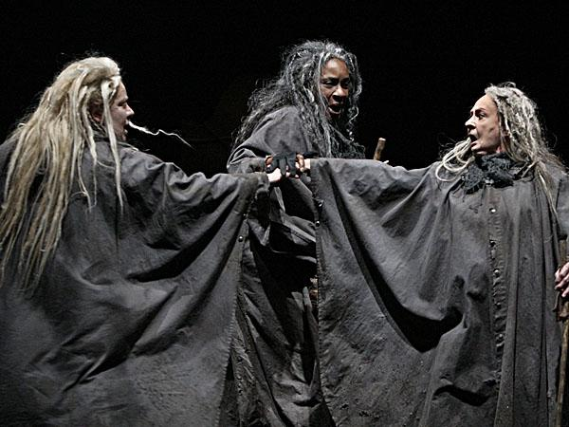
THEME – THE SUPERNATURAL/WITCHES!
James the Ist had a fascination with witches. He even wrote a book about them.
Therefore, it’s not surprising that the play, partially written to appeal to and flatter the King, opens with the witches.
From the beginning, the witches
are called out as unnatural – they
have beards!

Slide 16
THEME – THE SUPERNATURAL

Slide 17
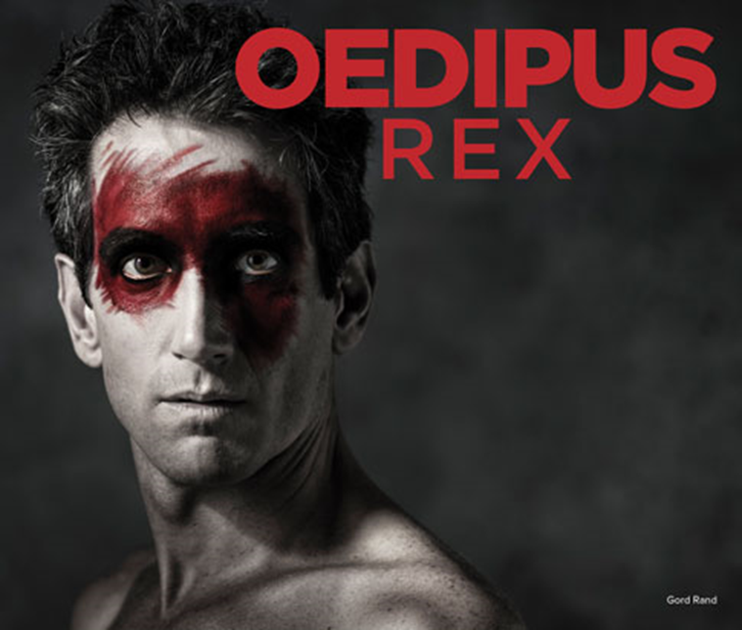
THEME – FATE AND DESTINY

Slide 18
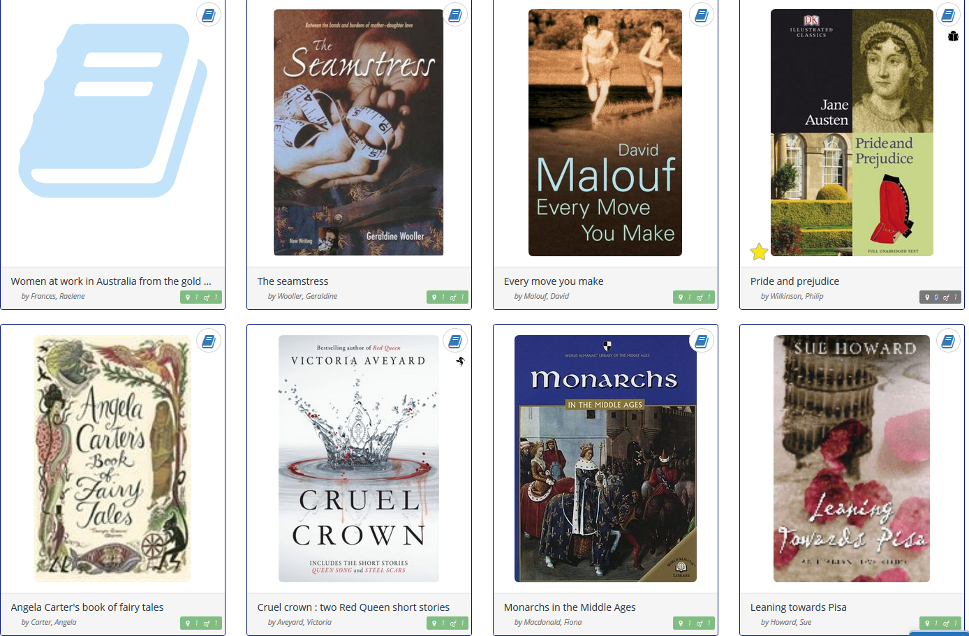
THEME - GENDER
The gender politics behind this story is quite interesting. In the beginning, it seems as if Lady Macbeth is the one that wears the trousers in this relationship.

Slide 19
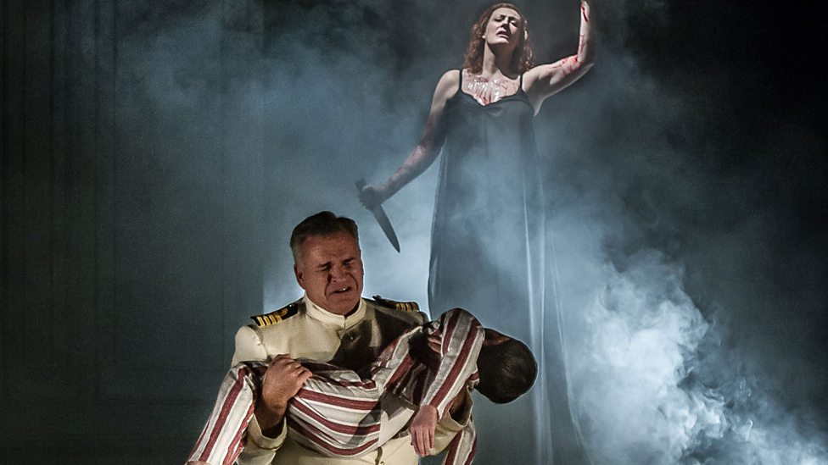
THEME – GENDER
MEDEA

Slide 20
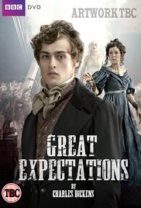
THEME – AMBITION
Great Expectations deals extensively with the theme of ambition, as young Pip tries to improve himself and his situation. Pip's brand of ambition would serve as an interesting contrast to Macbeth's.

Slide 21
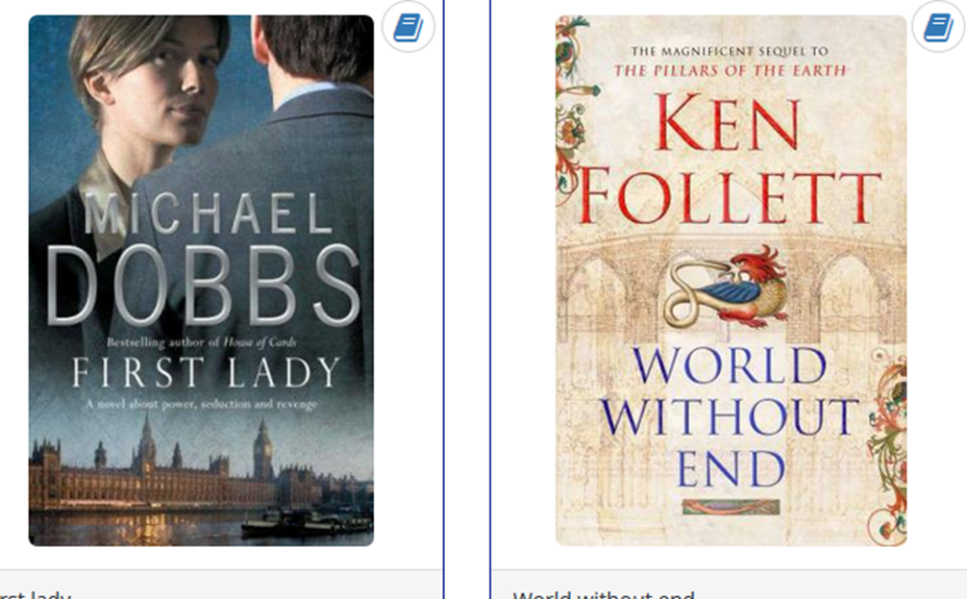
OTHER BOOKS ON THE THEME OF AMBITION
http://kidfocused.com/lance-armstrongs-tale-is-as-timeless-as-shakespeare/

Slide 22
THEME - AMBITION

Slide 23
THEME - POWER
In both, Lord of the Flies and Macbeth we see a similarity between how far each leader would be willing to go to have power and to keep the power he's obtained.

Slide 24
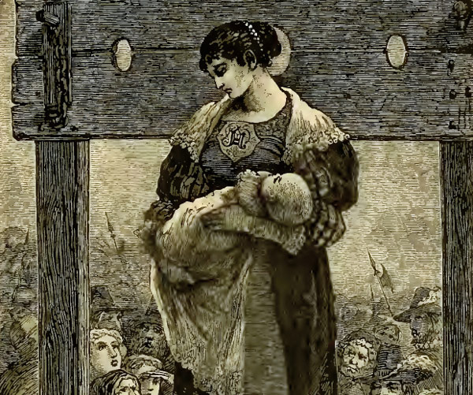
10 of the Most Powerful Female Characters in Literature
http://flavorwire.com/265847/10-of-the-most-powerful-female-characters-in-literature/3

Slide 25
THEME - GUILT
Macbeth has an internal conflict just like Holden in Catcher in the Rye.

Slide 26
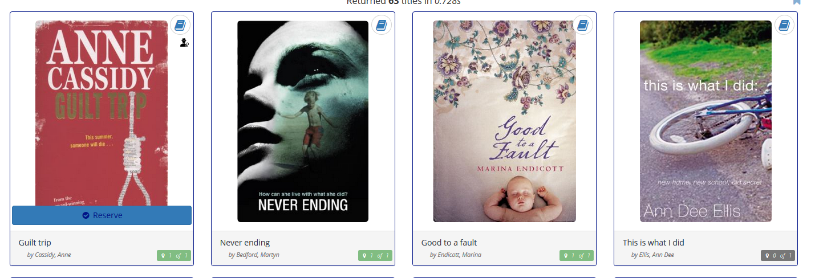
THEME - GUILT

Slide 27
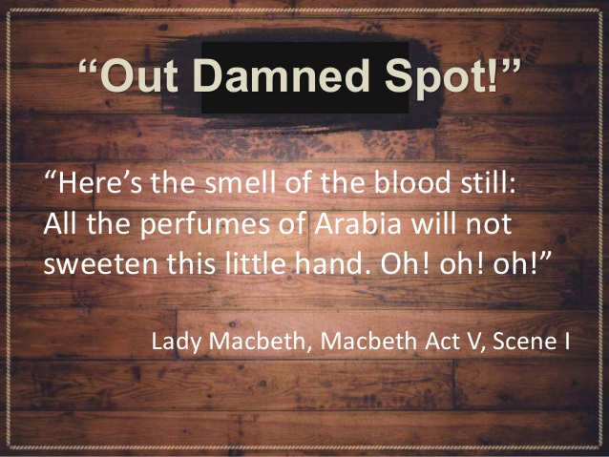
THEME - PSYCHOLOGY
Long before Sigmund Freud introduced the study of psychology, Shakespeare had a clue that it was possible for the mind to be affected by our actions and experiences.
In Shakespeare's play Macbeth, the characters display many characteristics of mental illness, primarily displayed in Act 5.
According to a study done by Stanford University of Medicine, people suffering from obsessive compulsory disorder and depression are more likely to sleep walk compared to those that do not. Lady Macbeth appears to suffer from both mental illnesses - obsessive compulsory disorder (OCD) and depression.

Slide 28
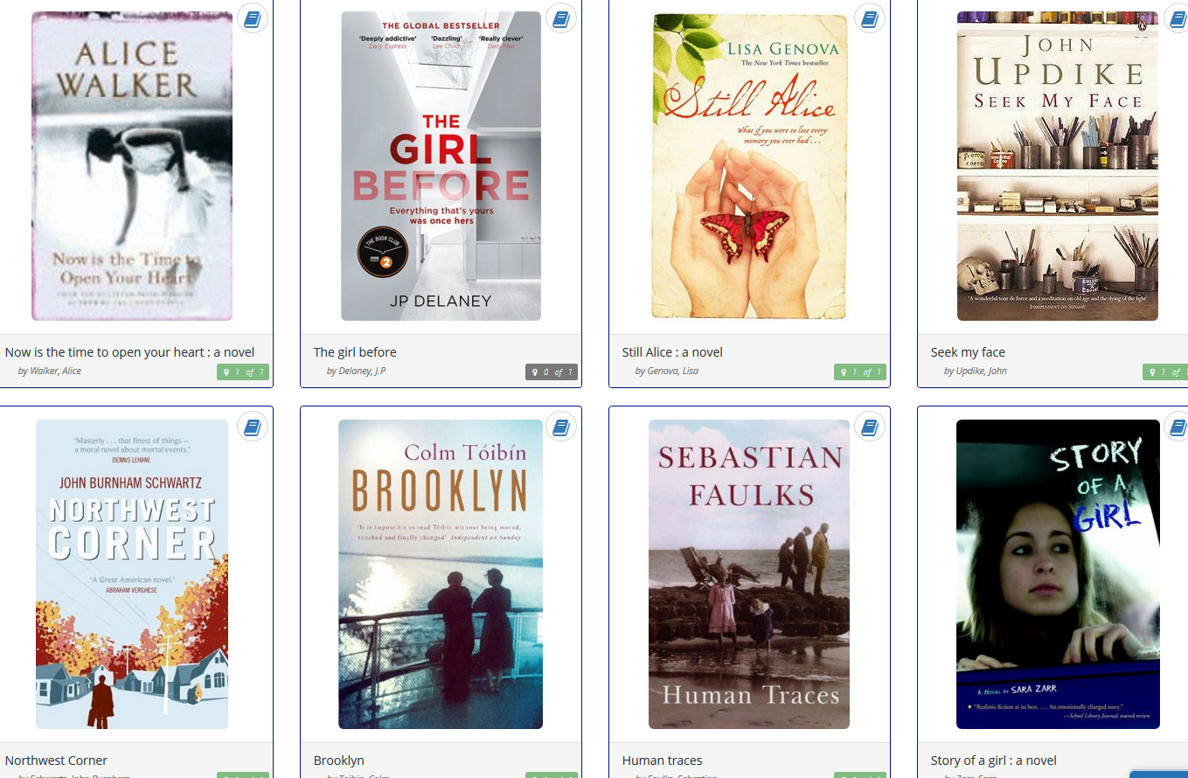
SOME BOOKS DEALING WITH PSYHOLOGY

Slide 29
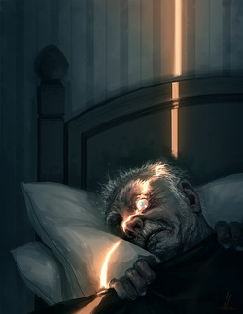
Short Stories
"The Tell-Tale Heart" by Edgar Allan Poe address the theme of guilt and insanity.

Slide 30
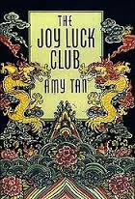
Short Stories
The short story "The Voice from the Wall" connects to Macbeth in that there is a conflict between what the main characters can see and what they hear.

Slide 31
Short Stories The Yellow Wallpaper
Lady Macbeth is much like the woman in the wallpaper in “The Yellow Wallpaper.” They’re both hidden under their husbands repression and assumed weak because of their gender.

Slide 32
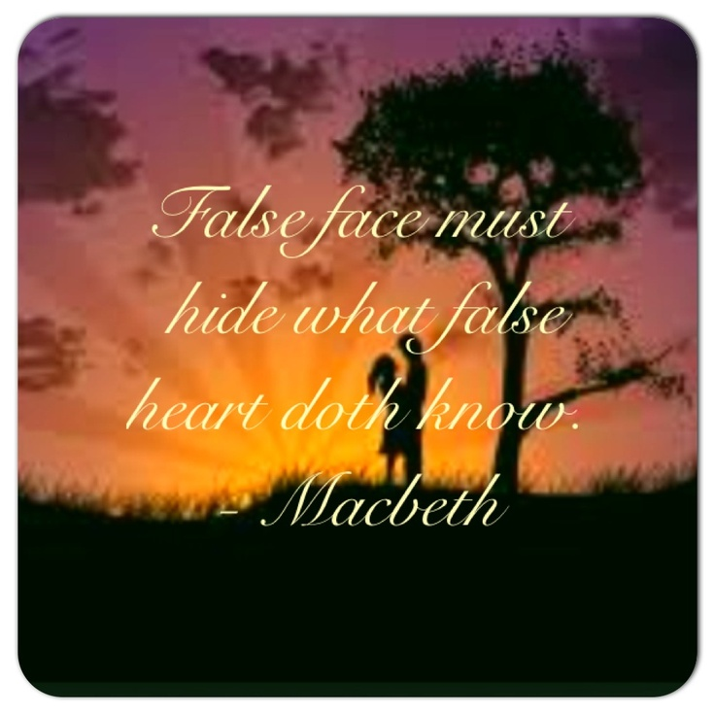
Summary
Shakespeare dealt with archetypes and concepts long before anyone knew such things existed, and his ability to take an emotion or a situation and push it to the limit helped create a cadre of plays that have been endlessly staged – and copied!
So your job is to find texts that are connected to the themes, ideas and characters in Macbeth

